Slide 1
CS 518-Web Programming Group 3.
MileStone-3 Midway Report

Slide 2

CryptoTalk!
By:-
Aniket Chandak
Aniket Nawade
Akshay Dabade

Slide 3
Contents:
Milestone 2 Achievement
Milestone 3 Requirements
Pagination
Administration
User Profile
Screen Shots
Challenges

Slide 4
Requirements
Pagination
Embed text and image
Administration
User profiles

Slide 5
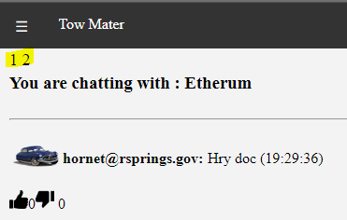
Pagination
Displays 10 messages per page.
Most recent post will be at top.
Pagination

Slide 6
Embed text and image
Format text based on user input
1
Post images from web in post
2
Post image from local machine.
3

Slide 7
Administration
Invite users
Delete posts
Edit channel
Archive channel

Slide 8
User Profile
User metric
View user profile

Slide 9
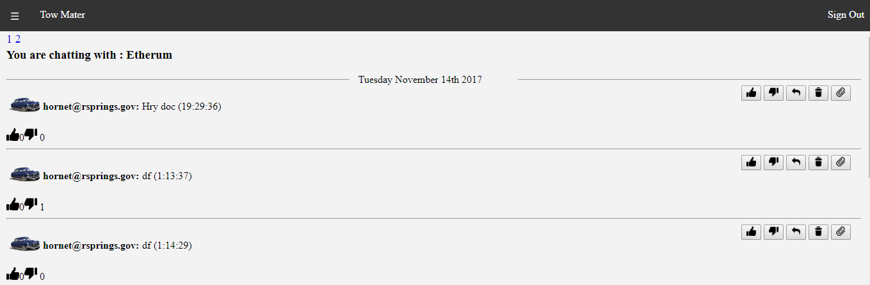
Screen Shots
Pagination

Slide 10
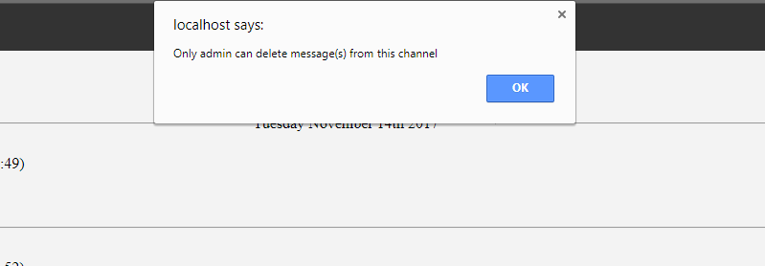
Screen Shots
Delete message

Slide 11
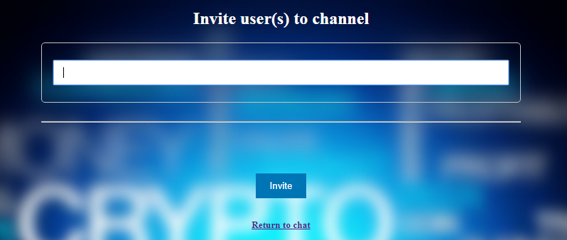
Screen Shots
Invite users

Slide 12
Thank You
Questions?

